Slide 1

BANK APPLICATION
TEAM MEMBERS:
Ashwini Sudhakar Shinde
Chithra Priya G
Aiswarya K
Puttaparthi Mounika
Sudharsan V

Slide 2
INTRODUCTION
Bank Application enables users to use basic functionalities of Banking.
In this application, user will create their own account using their information and they will get login credentials to access banking facility.
Using this application we can transfer, deposit and withdraw money from and into the bank.
Also we can find our bank balance and bank statements through this application.

Slide 3
Technology used
Software : Eclipse and Oracle
Backend : Java 1.8,Spring boot, Spring security and JPA
Frontend : HTML 5,CSS ,Thymeleaf
Database : Oracle 11 g
Server : Tomcat 8.5

Slide 4
FLOW CONTROL
LOGIN
DEPOSIT
REGISTER
WITHDRAW
TRANSFER
USER
CHECK BALANCE
LOGIN
BANK STATEMENT

Slide 5
MODULES
LOGIN
REGISTER
DEPOSIT
WITHDRAW
TRANSFER
CHECK BALANCE
PROFILE
BANK STATEMENT
EDIT MOBILE NUMBER
FORGOT PASSWORD

Slide 6

Index Page
While clicking in Signin or Get Started you can Signin or Sign up into your account.
If you want to contact us you can click on the contact button , then you can find our contact details.
If you want to know more about our application you can click on the about us button.

Slide 7
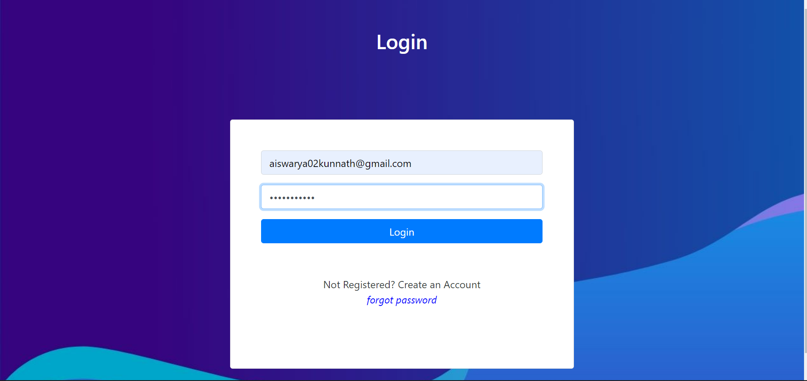
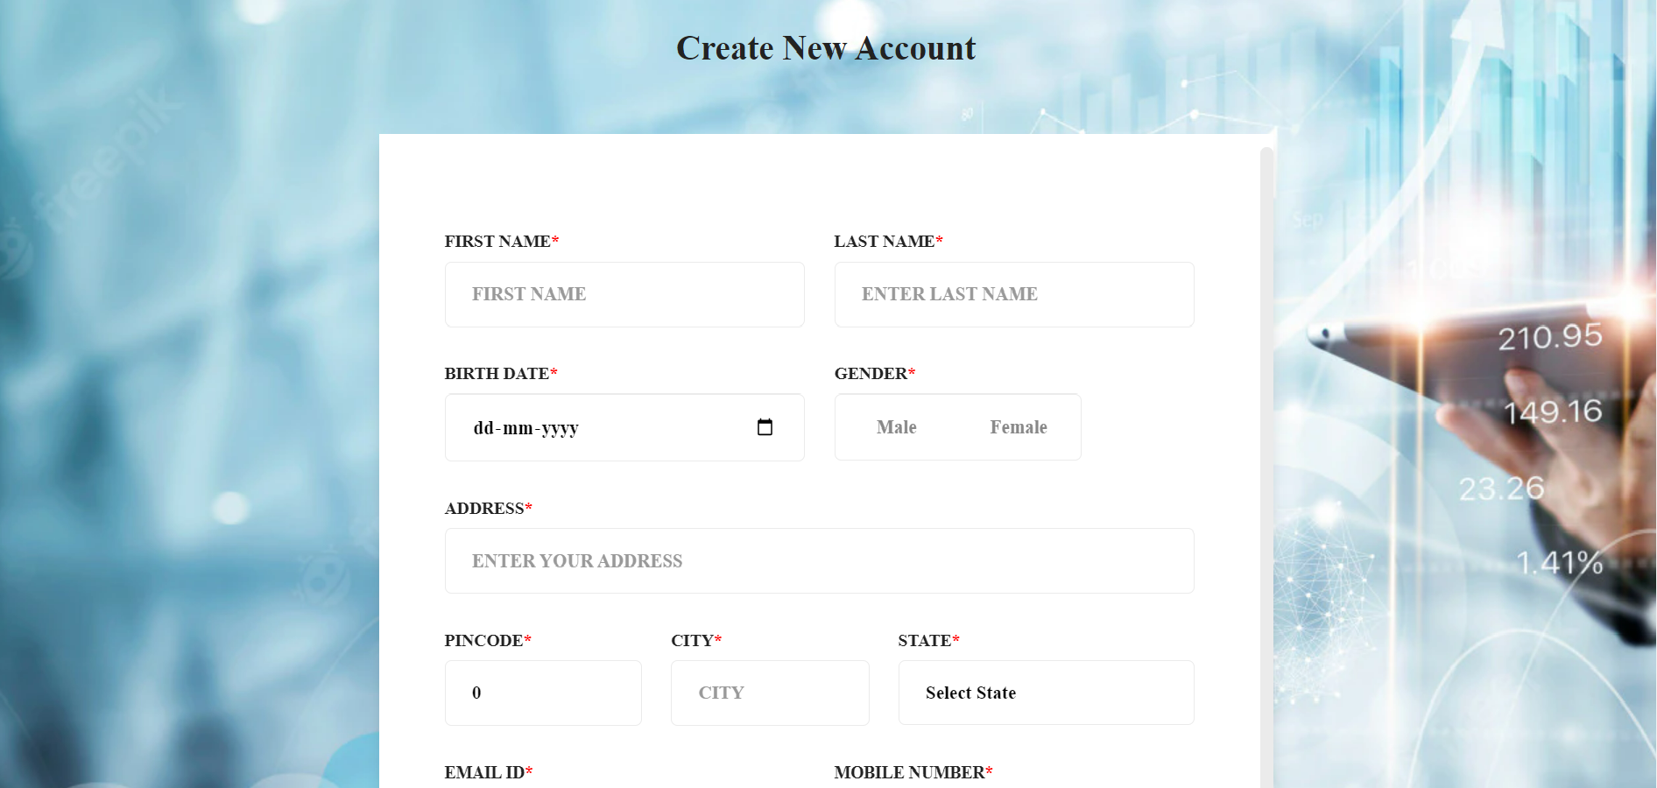
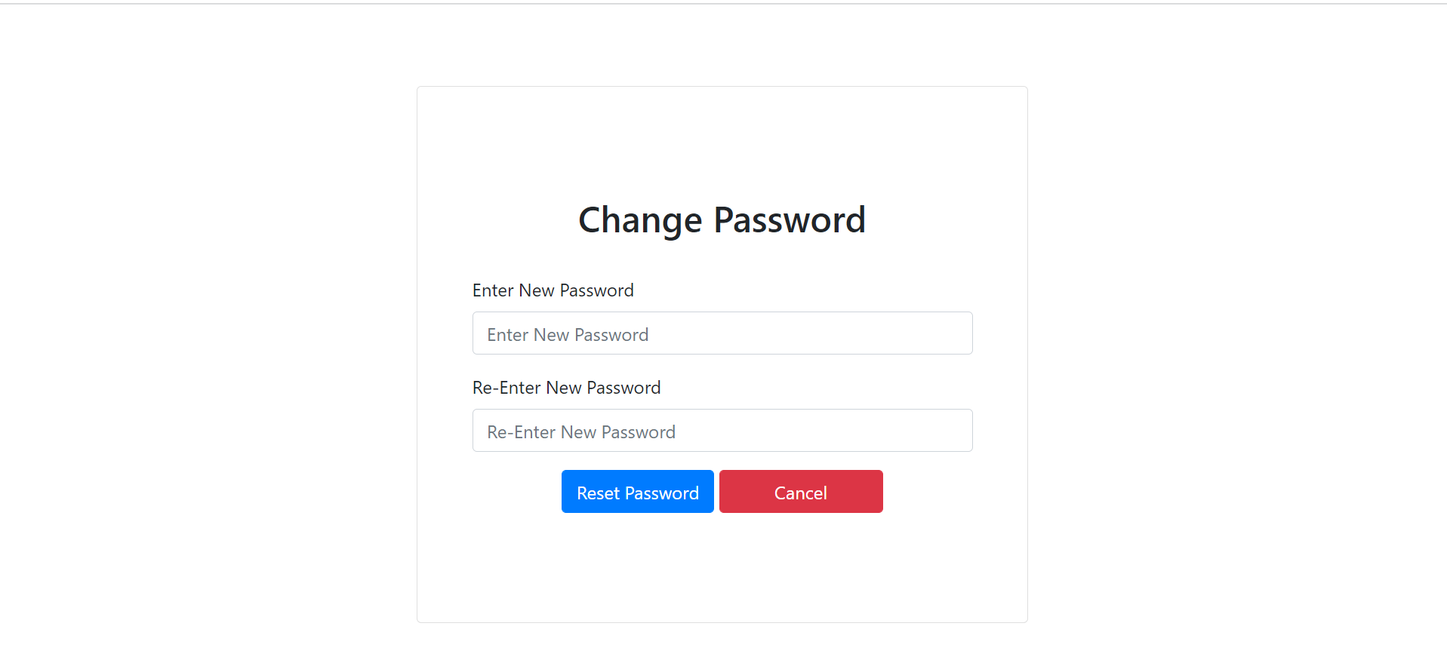
You can Login into your own account using the login credentials which you entered during the registration.
If you are not registered, you need to click on Create an Account. Then you can register your account by providing your own details.
If you forgot your password, you can click on the forgot password then you can reset the password.

Slide 8
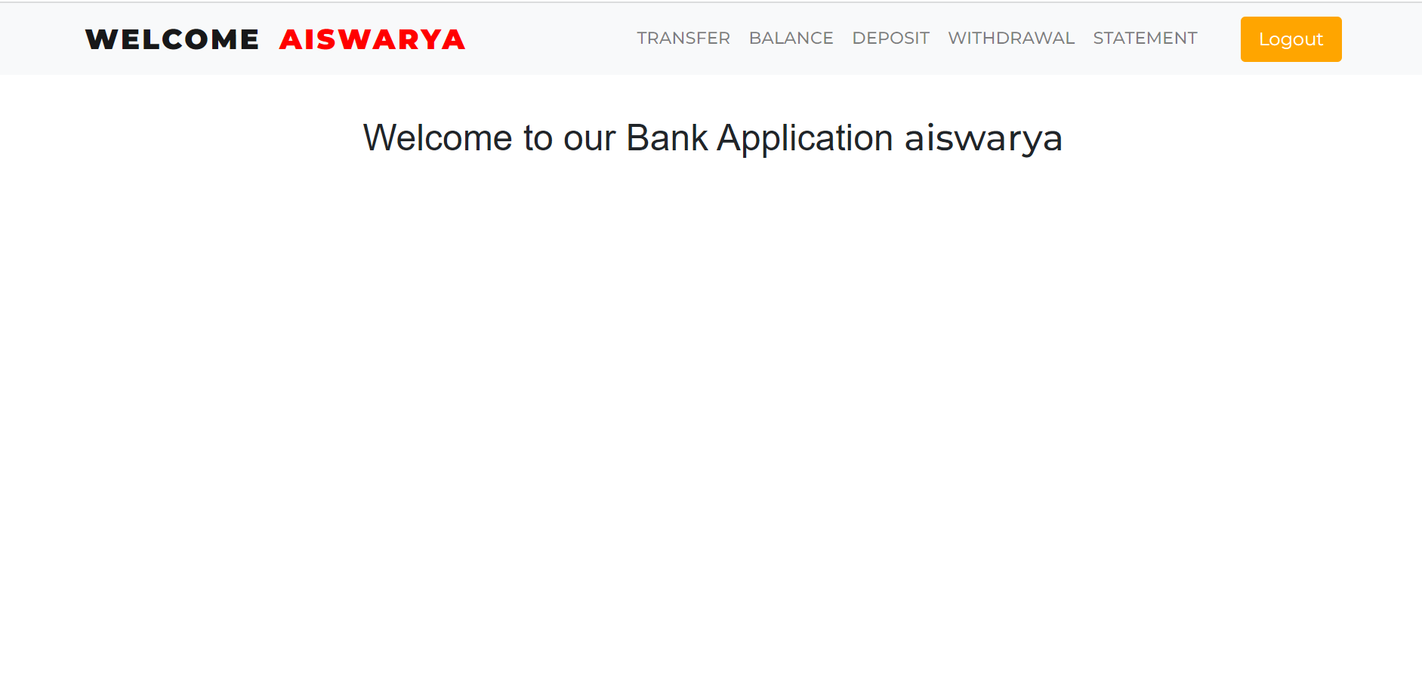
After login you will enter into home page.
Here we provided our main modules list. Based on your requirement you can choose the modules. i.e. if you need to deposit money you can click on the deposit module.

Slide 9
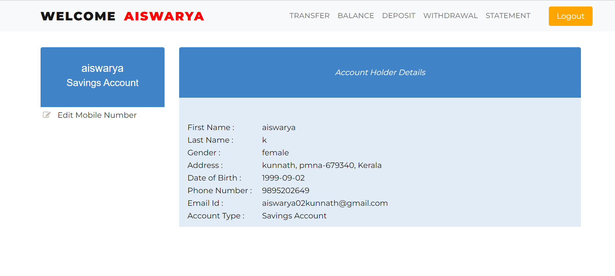
User Profile
When you click on your name , you can see your details which you have entered during the registration time.
Also you can change your mobile number if you needed by clicking Edit Mobile Number.

Slide 10
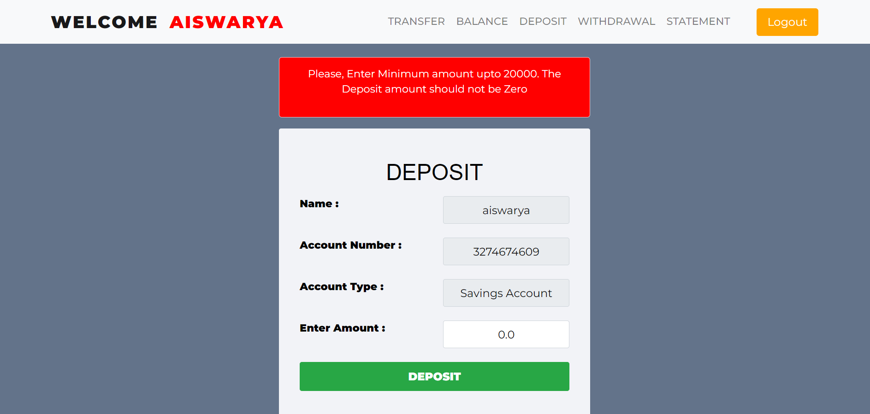
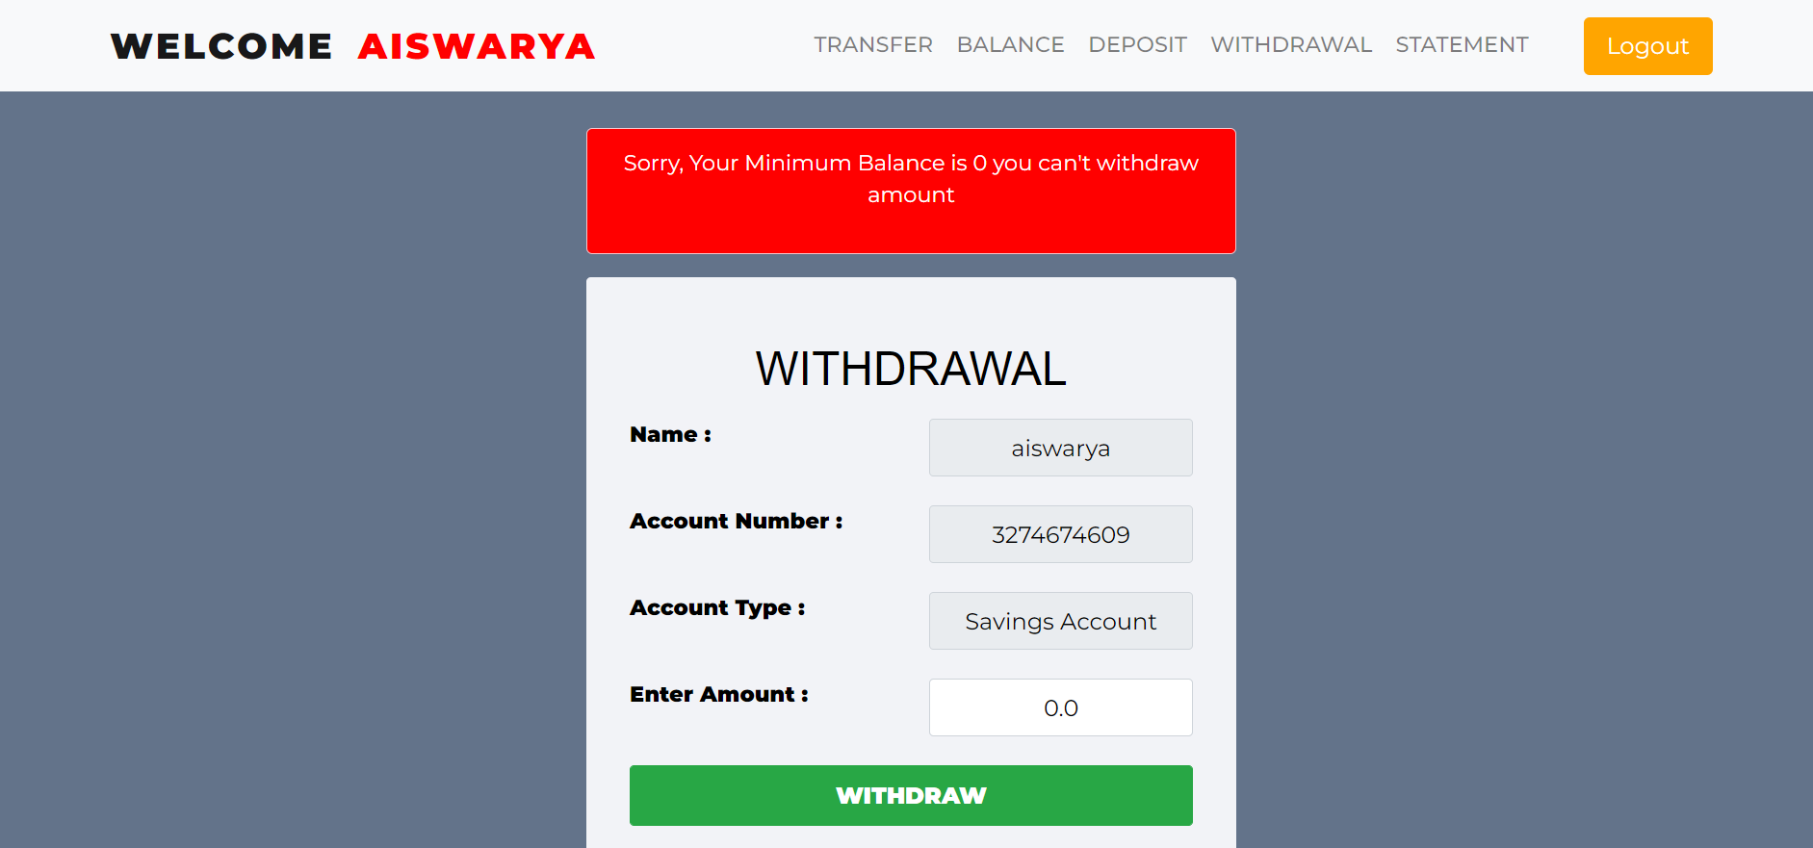
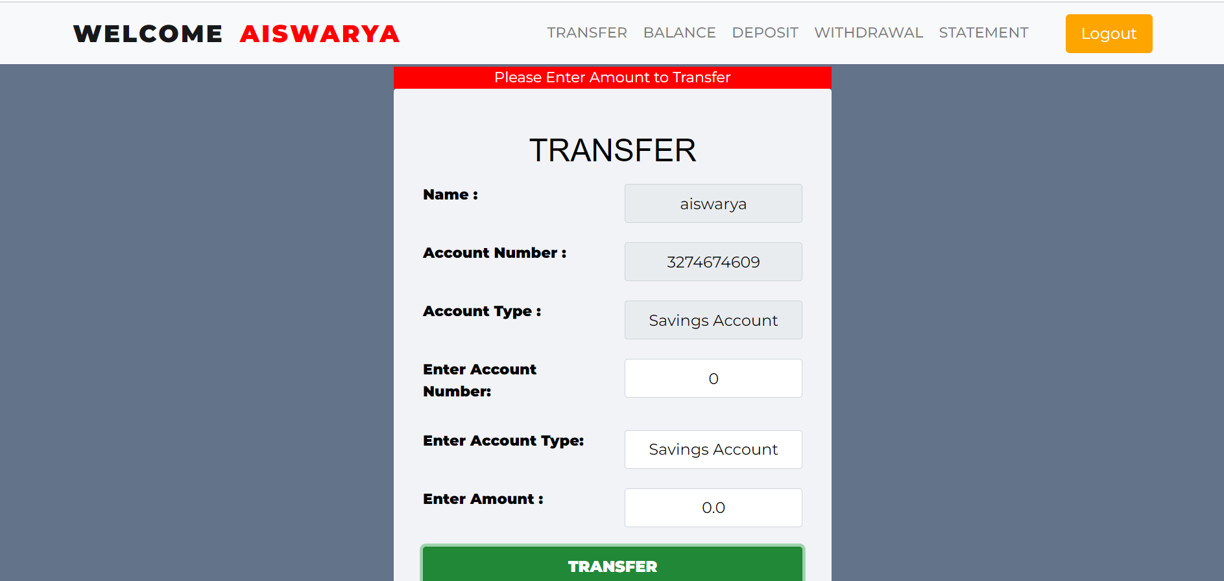
Deposit Module
You can deposit from up to 20000/- in the case of savings account and 40000/- in case of current account.
Withdrawal module
Here you can withdraw any amount based on your requirement.
Balance should not be zero.
Transfer module
Here you can transfer any amount of money to other accounts.

Slide 11
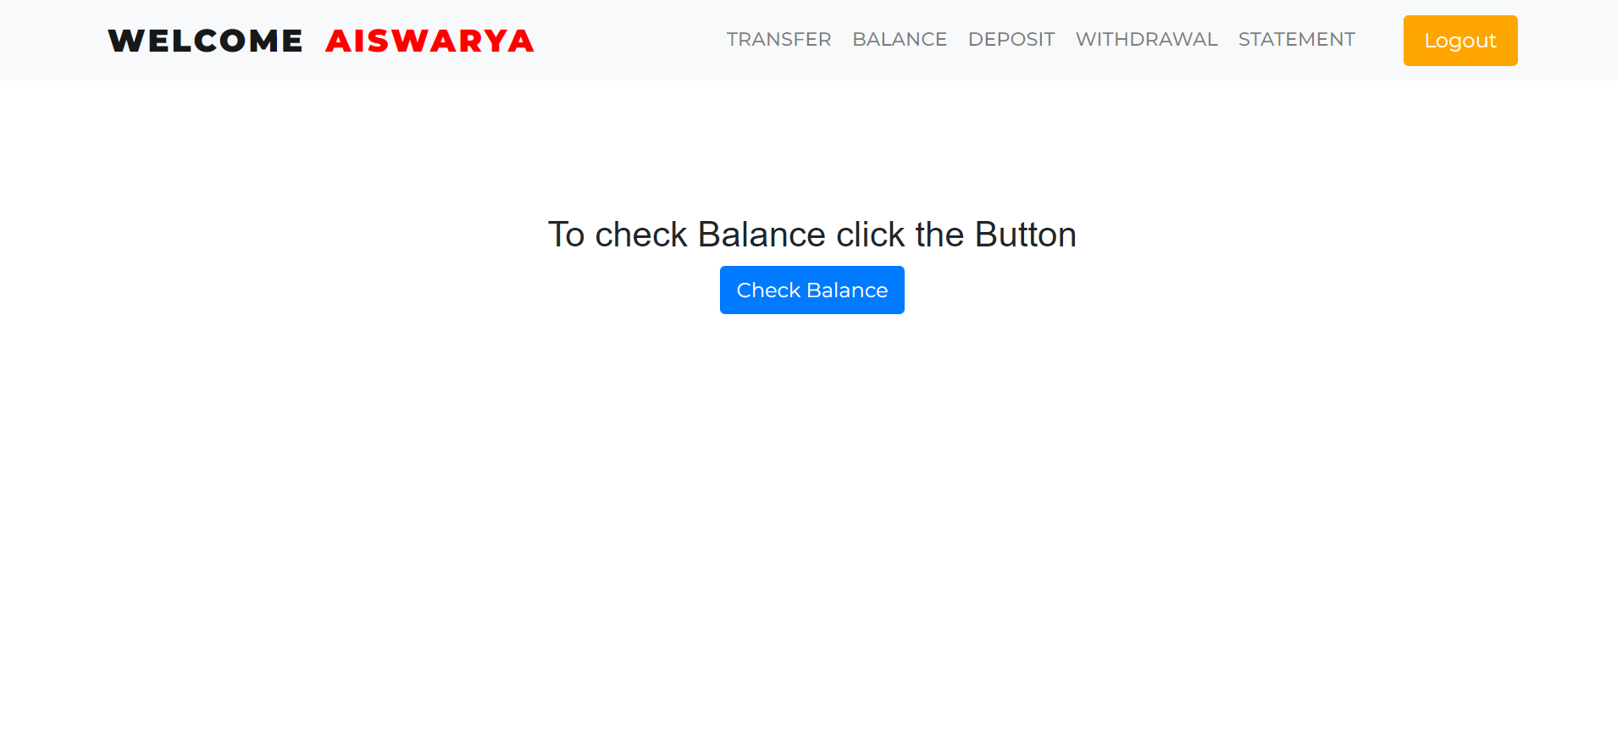
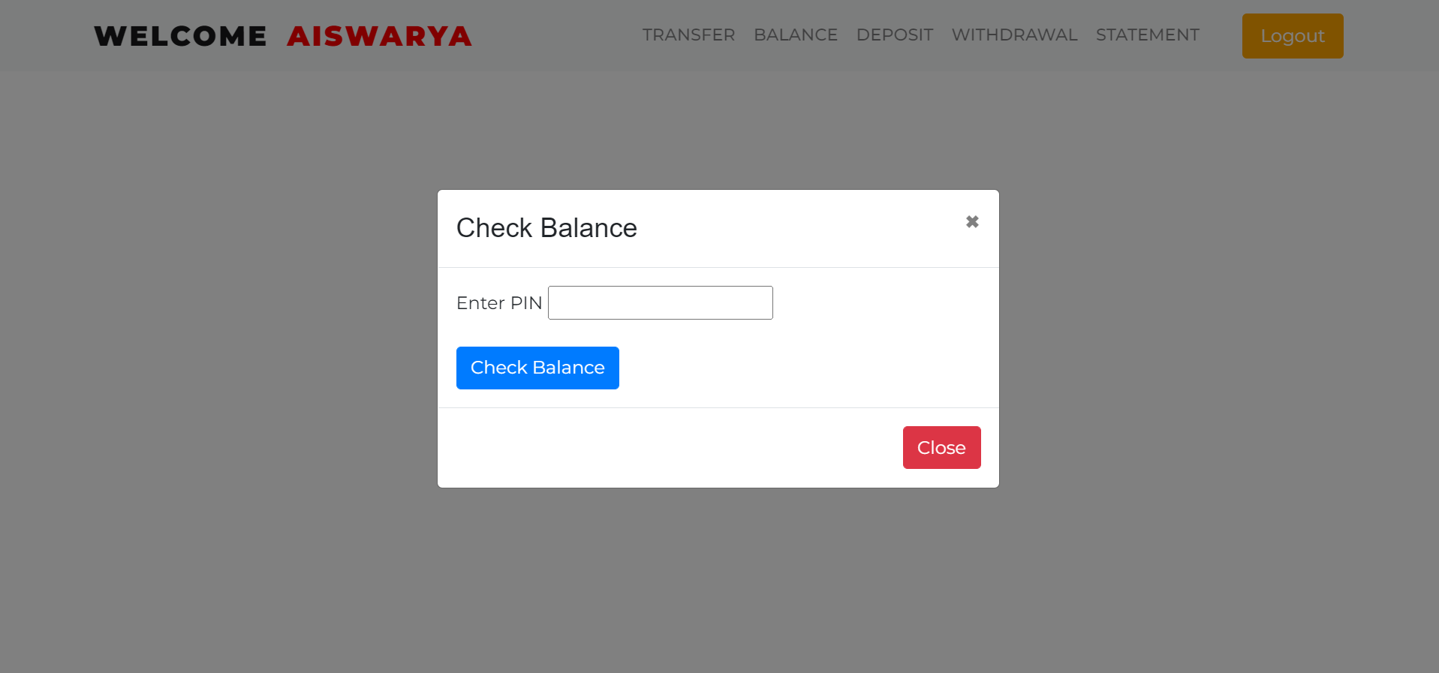
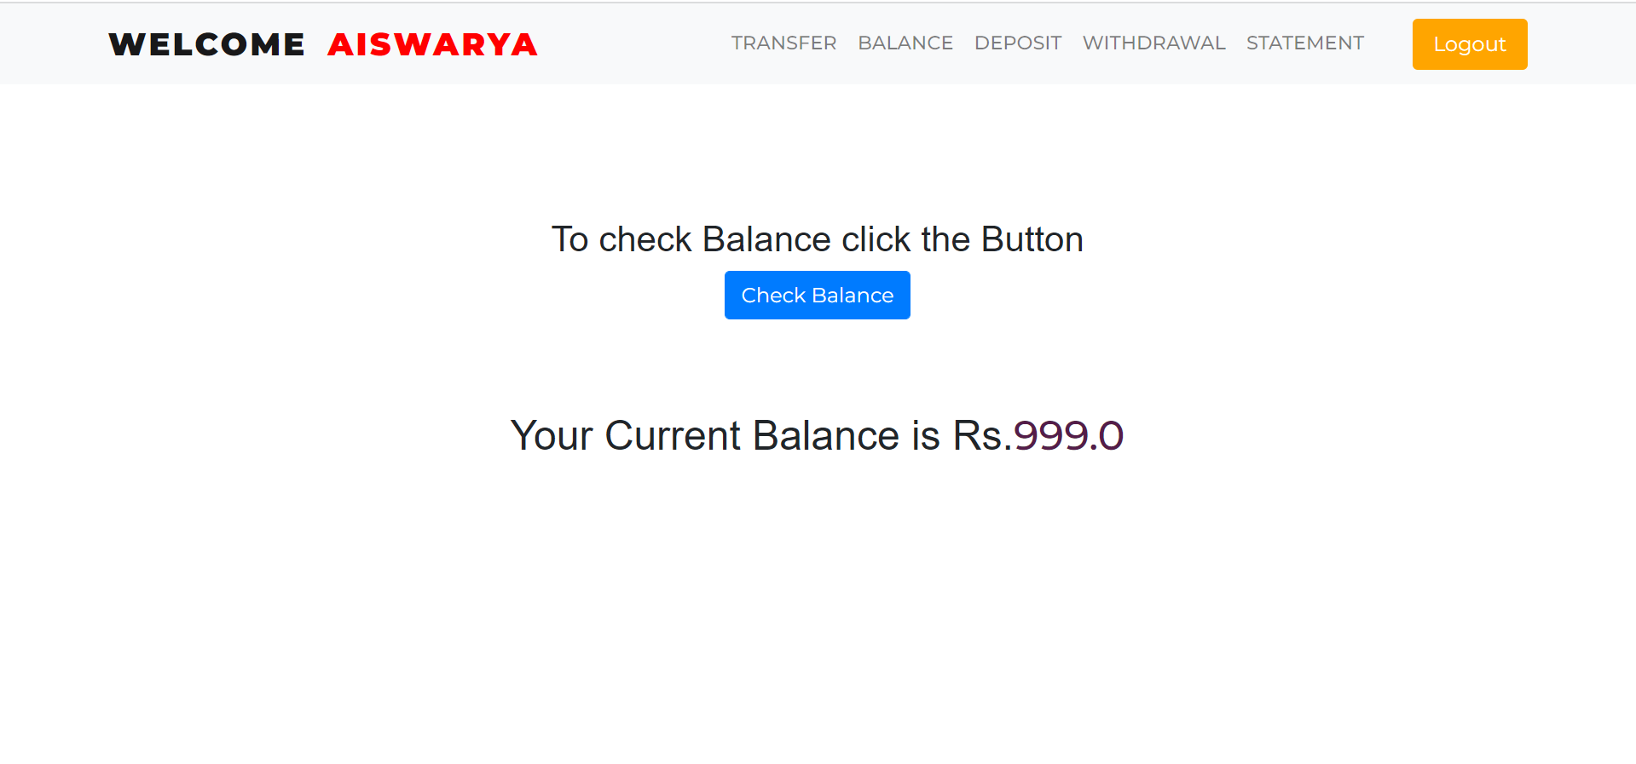
You can check you bank balance through our balance module.
Here you need to click on check balance.
Then here we need to enter our pin (password).
Finally you can see your total bank balance like in the image.

Slide 12
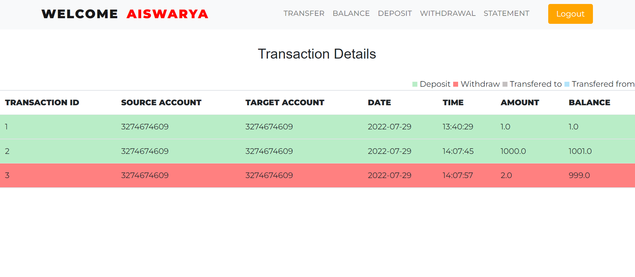
When we click on the statement module, You can see your complete transaction details with proper time, date , account number and amount details.
If you want to logout from our page, you can simply click logout.

Slide 13
THANK YOU

